Slide 1

Advanced SQL Reinforcement project- IMDB dataset
AJAY.P
DA&DS-ONLINE
MARCH-2025
28/05/2025

Slide 2

Data set – IMDB introduction
The dataset provided is a simplified version of the IMDb database, structured to capture
essential information about movies, their genres, actors, directors, ratings, and more. This
database consists of several tables that contain various details.
Project Objective
key SQL concepts such as joins, aggregation, filtering, and grouping.
Analyze and extract meaningful insights from a real-world movie dataset. .

Slide 3

SQL OVERVIEW
WHICH SQL MATTERS I USED IN THIS PROJECT :-
Joins: Connecting different tables (Movie, Ratings, Names) for comprehensive data retrieval.
Aggregation: Summarizing key trends such as genre popularity, average movie duration, and director activity.
Filtering & Grouping: Segregating movies based on their release year, country, and ratings to find patterns.
Data Cleaning: Identifying missing values and ensuring accurate calculations.

Slide 4

TABLES OVERVIEW
Contains basic information about each movie, including title, release year,
duration, country, income, languages, and production companies.
MOVIES
Describes the genres associated with each movie.
GENRE
DIRECTOR MAPPING
Maps movies to their directors.
ROLE MAPPING
Maps actors/actresses to movies and specifies the role category (e.g.,
actor, director, producer).
NAMES
Stores information about people (actors, directors, etc.), including theirs
birthdates, heights, and known movies.
RATINGS
Contains ratings information for movies, including the average rating, total
votes, and median rating

Slide 5

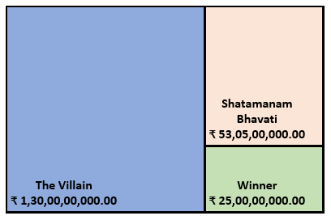
VISUAL INSIGHTS (CHARTS):-
YEAR WISE MOVIES
TOP 3 COLLECTION BY MOVIES
GENRE WISE MOVIES

Slide 6

VISUAL INSIGHTS (CHARTS):-
TOP 10 PRODUCTION COMPANY BY TOTAL VOTES
TOP 10 MOVIES BY AVG_RATING

Slide 7

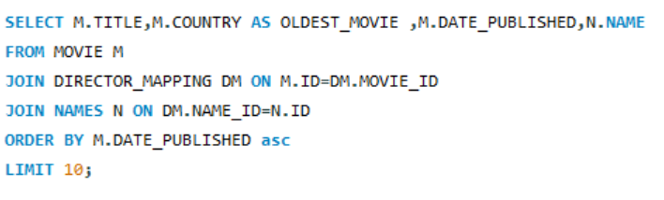
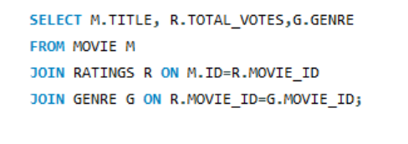
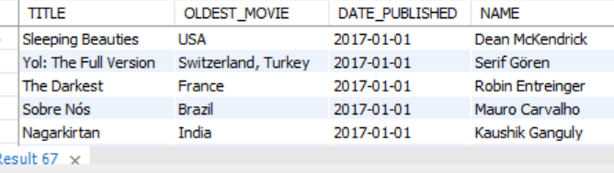
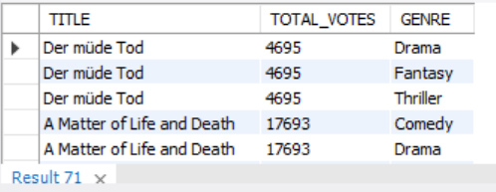
SQL –SNIPPETS (SCREEN SHOTS ):-
JOINS..

Slide 8

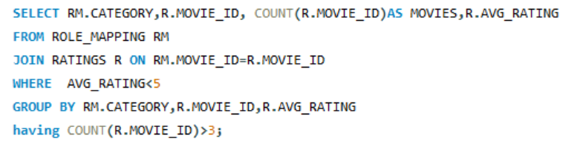
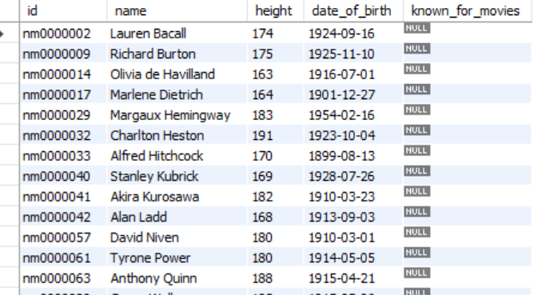
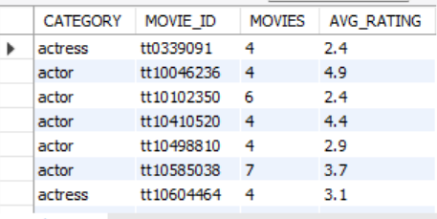
SQL –SNIPPETS(SCREEN SHOTS) :-
GROUPING & FILTERING …
THE WHERE CLAUSE IS USED TO ROW LEVEL FILTERING
.
THE GROUP BY CLAUSE IS USED TO GROUP DATA .
HAVING CLAUSE IS USED TO FILTER GROUPED DATA.

Slide 9

CHALLENGES FACED :-
DUBLICATE RECORDS : you may need distinct , group by to clean this.
HANDLING NULLS : many fields (e.g., height ,birthdate , production company , etc..)
COMPLEX JOINS BETWEEN TABLES : required to gather data across multiple tables.
ONE-TO-MANY RELATIONSHIPS : a movie may have multiple genre ,directors , or actors.

Slide 10
Conclutions :-
SQL SKILL STRENTHENED WITH REAL DATASET.
KEY INSIGHTS DERIVED FROM DATA USING ADVANCED QUERIES.
ENHANCED UNDERSTANDING OF MOVIE_RELATED DATA STRUCTURE.

Slide 11

Q & A
THANK YOU !!!
ANY QUESTIONS ?

